Slide 2
AWS & Impetus GenAI Hackathon

Slide 3
GenAI-Powered Retail Sales Forecasting and Inventory Optimization
JINEN MODI
Note: All submissions remain the intellectual property of the individuals or organizations that developed them, and go on to describe a non-exclusive, royalty-free license granted to the sponsor, rather than a full transfer of ownership.

Slide 4
Introduction
About Me:
I am Jinen Modi, a data engineer and machine learning enthusiast with a passion for building impactful AI-driven solutions.
Role and Responsibilities:
I single-handedly designed, developed, and deployed this end-to-end AI-powered retail sales forecasting system. This involved data engineering, model development (XGBoost and TimeLLM), cloud infrastructure setup with AWS, and creating an accessible, interactive Streamlit UI.

Slide 5
Problem ​statement​
Retailers face significant challenges in accurately forecasting demand for thousands of products across multiple stores and departments. Poor demand forecasting leads to stockouts, lost sales, and excess inventory, which increase costs and reduce customer satisfaction.
This project addresses the critical need for precise, scalable, and explainable demand forecasting in retail supply chains. Our solution focuses on:
Generating accurate weekly sales forecasts at store-department level
Leveraging advanced machine learning models (XGBoost, TimeLLM)
Providing real-time, actionable inventory recommendations
Integrating voice-driven commands and interactive analytics
Supporting accessible and user-friendly interfaces for business users
By tackling these, we aim to improve inventory management efficiency, reduce wastage, and enhance overall retail operational excellence.

Slide 6
Solution approach​
Our solution leverages a fully integrated end-to-end architecture combining advanced machine learning, modern cloud services, and an intuitive user interface to tackle retail demand forecasting and inventory optimization.
Key Features:
Data Engineering Pipeline: Automated data ingestion, cleaning, and transformation using AWS Glue and S3, ensuring scalable and reliable data flow.
Hybrid Forecasting Models: Employs classical XGBoost models grouped by store types for precision, augmented with generative AI via our custom GPT2-powered TimeLLM for explainable and adaptable forecasting.
Real-Time Interaction: Voice-driven input through Amazon Transcribe, with speech output via Amazon Polly, creating a seamless conversational forecasting experience.
Inventory Optimization & Alerts: Rule-based reorder alerts powered by forecast insights, integrated with AWS SNS for real-time notifications.
Robust Access & Monitoring: User authentication, logging, and audit trails to ensure security, transparency, and traceability.

Slide 7
Scope of Scaling:
Horizontal: Easily extendable to thousands of stores and product categories by leveraging serverless AWS infrastructure, Glue, Athena, and scalable ML models.
Vertical: Modular architecture allows upgrading models to more sophisticated GenAI approaches and adding deeper supply chain optimization modules without disrupting existing workflows.
This design ensures a robust, scalable, and business-ready forecasting platform that adapts and grows with retail operational demands.

Slide 8
Tech-stack selection​
Tech-Stack Selection
Models & Frameworks:
XGBoost: Proven gradient boosting framework for tabular retail sales data, enabling highly accurate demand forecasts tailored by store type.
Custom GPT2-based TimeLLM: Cutting-edge generative time series model for advanced forecasting and explainability, built with PyTorch.
Python: Core language for data processing, model training, and Streamlit frontend development.
AWS Services:
AWS Glue: Serverless ETL for scalable data ingestion, cleaning, and transformation across multiple raw datasets.
Amazon S3: Centralized data lake and model artifact storage for robustness and accessibility.
AWS Athena: Interactive querying on cleaned Parquet datasets for quick data exploration and integration.
AWS SageMaker: Model training and scalable deployment (planned/partially integrated).
Amazon Transcribe & Polly: Voice input/output integration for accessible and interactive forecasting.
Amazon SNS: Real-time alerting system for inventory reorder notifications.

Slide 9
Additional Technologies:
Streamlit: Rapid web app development with support for interactive dashboards, voice integration, and accessibility.
Pandas & PyAthena: Data processing and querying libraries ensuring smooth integration between AWS data sources and local workflows.
Reasons for Selection:
Scalability and flexibility with AWS serverless architecture to handle large volumes of retail data efficiently.
Hybrid approach combining classical ML and generative AI offers both accuracy and adaptability.
Streamlit and voice services improve accessibility and user experience for diverse stakeholders.
Modular and cloud-native design ensures easy future extensibility, monitoring, and operational robustness.

Slide 10
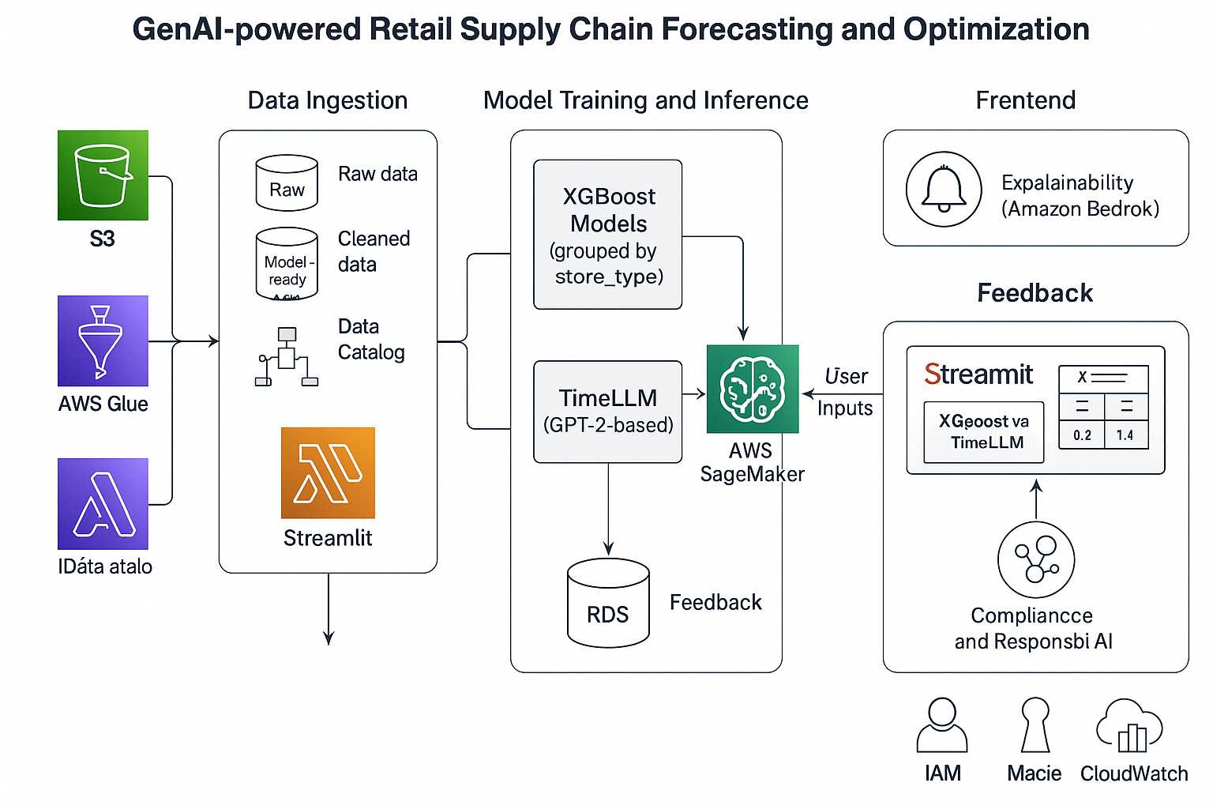
Architecture design/diagram

Slide 11
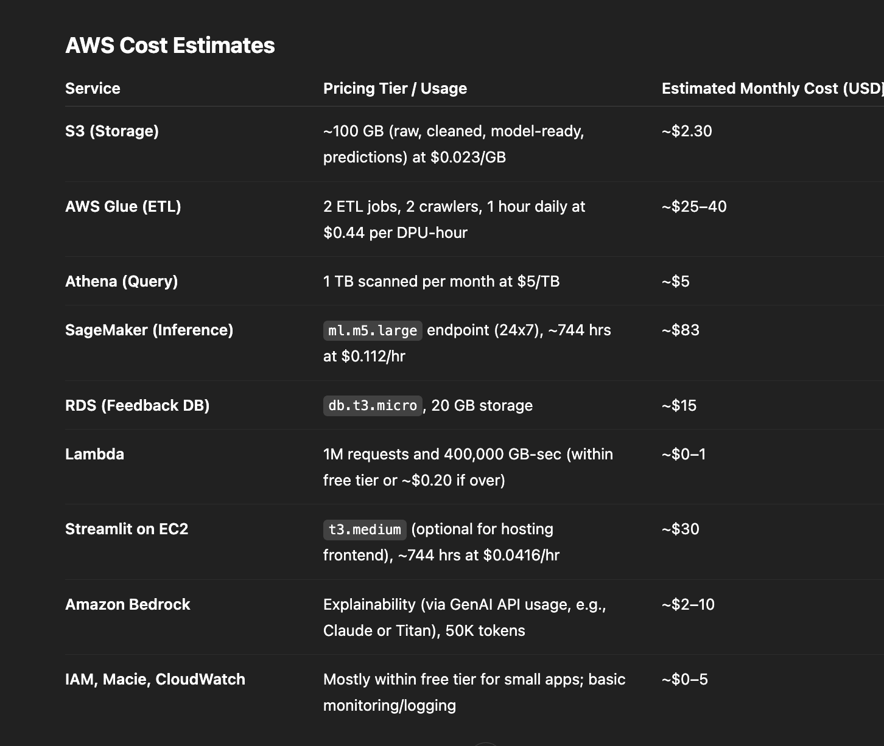
Cost estimates​

Slide 12
Impact potential & limitations​
Potential impact
Modernizes retail supply chain planning with GenAI-enhanced forecasting.
Scalable to large enterprise datasets and multi-store deployments.
Drives smarter business decisions by reducing forecast error and demand shocks.
Benefits
Combines explainable AI (XGBoost) and generative forecasting (TimeLLM).
Serverless and cost-efficient with AWS-native tools.
Real-time user feedback loop enhances model robustness and adaptability.
Supports accessibility features (voice input/output, screen readers).
Dependencies
AWS Services: Glue, S3, Athena, SageMaker, Bedrock, RDS, Lambda, IAM.
Python Libraries: pandas, xgboost, transformers, boto3, streamlit.
TimeLLM model adapted from open-source GitHub repository.
Internet access required for Bedrock API integration.

Slide 13
TimeLLM inference cost and latency are higher than traditional models.
Requires historical data for optimal accuracy — cold-start still a challenge.
Some services (e.g., Bedrock, SageMaker) may incur extra costs if scaled.
Explainability for TimeLLM is experimental; not as mature as tabular models.

Slide 14
Ethical & security considerations​
Data Privacy and Security
All data is stored in Amazon S3 with strict access controls using IAM policies.
Personally identifiable information (PII) is excluded from all datasets.
Monitoring and logging are enabled using AWS CloudWatch to ensure traceability and incident response readiness.
Responsible Use of AI
Forecasting outputs from TimeLLM are complemented with interpretable XGBoost models to enhance transparency.
Amazon Bedrock is used for model explainability to ensure accountability in predictions.
Bias detection strategies are under consideration for future implementation.

Slide 15
Compliance and Governance
Data classification and automated sensitivity detection are handled through AWS Macie.
Role-based access control (RBAC) ensures only authorized users can interact with critical system components.
A feedback mechanism is integrated to allow users to report issues or inaccuracies, promoting continuous improvement.
Identified Ethical Risks and Mitigations
Forecasting Bias: Groupwise training ensures fair treatment of different store types and sizes.
Overreliance on AI Outputs: Human-in-the-loop workflows are encouraged to validate predictions and override where necessary.

Slide 16
Project URL, video pitch & demo
Project Pitch Video (3 Minutes) A short video walkthrough explaining the project motivation, approach, architecture, and GenAI integration strategy. →https://youtu.be/5XUIq1OunpQ
Dry-Run Application Demo The video also includes a live demonstration covering:
Data ingestion and transformation using AWS Glue and S3
Forecasting outputs from XGBoost and TimeLLM
Explainability interface using Amazon Bedrock
Real-time feedback and visualization via Streamlit

